Slide 1
Lecture 21 Classes Pt. 1 Attributes and Methods
CSC111: Introduction to CS through Programming
R. Jordan Crouser
Assistant Professor of Computer Science
Smith College

Slide 2

Announcements 1/2
*unless you have extended time
Midterm is over, you made it!
Don’t panic if you forgot to hit “Submit”; Moodle auto-submitted anything that was still underway at 9am this morning*
Grading will happen over the next week or two, returned via Moodle
A big welcome to Somil Gupta!
UMass MS candidate in NLP
Prior work at Amazon and Google
Will be working with us to provide feedback on assignments beginning with A4

Slide 3
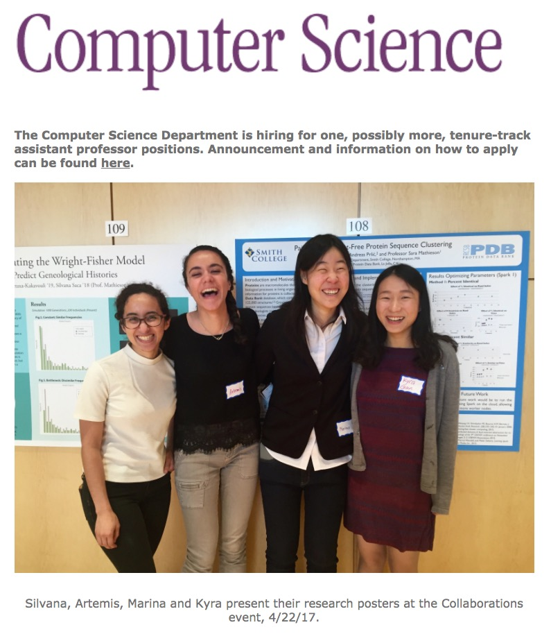
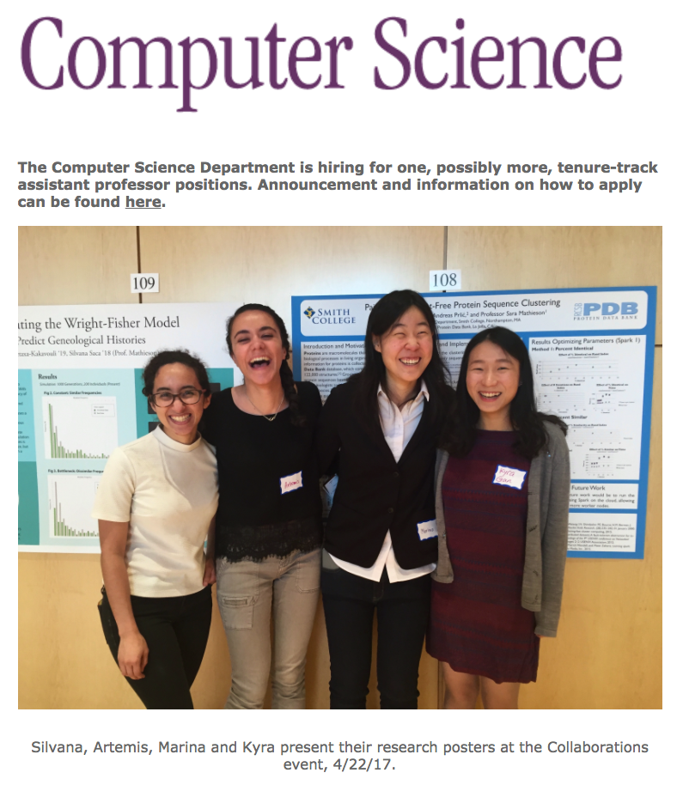
Announcements 2/2
Presentation of the
CS Major & Minor
Thursday 10/29
11:30am – 1:30pm EST
Zoom link posted
to Discord

Slide 4
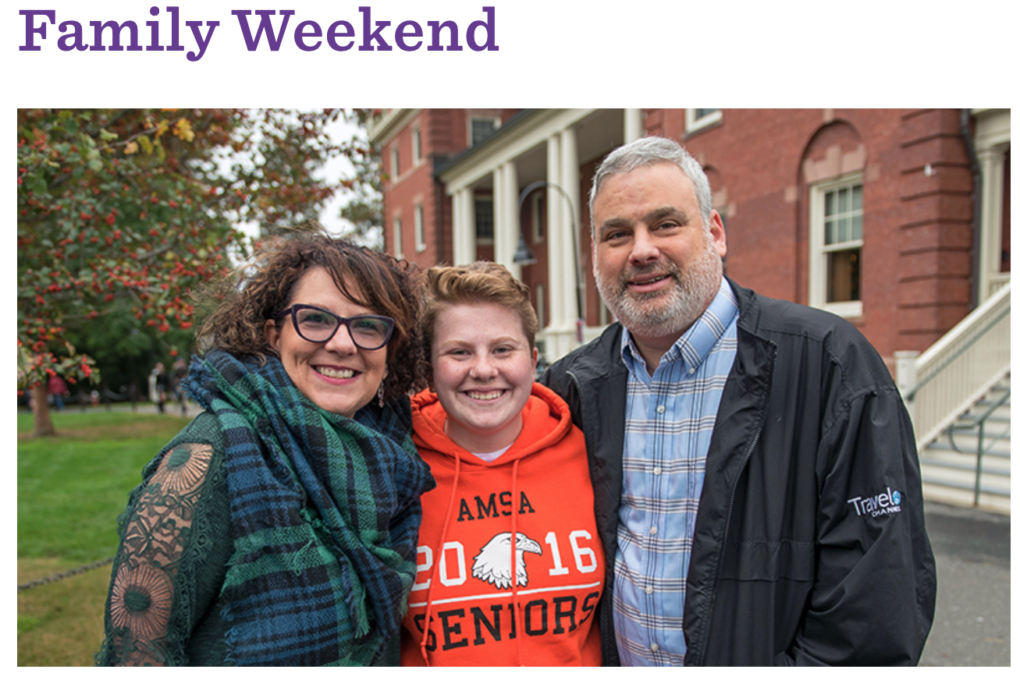

Slide 5
Coming up
Today: Classes pt. 1: attributes and methods
Monday: Classes pt. 2: object-oriented programming
Lab: working with classes
Wednesday: Classes pt. 3: inheritance
Friday: Introduction to Algorithms

Slide 6

A4 recap: Music Library
How did it go?

Slide 7
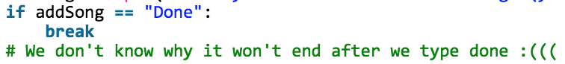
Jordan’s observations
Overall really nice!
Getting the hang of dictionaries, lists, etc.
Common problem: getting “done”, “play”, “print” commands to work (this was tricky!)
Tips:
Remember: functions help to organize your code
Think about your data structures: simple things should be easy
Keep leaving lots of comments (esp. if something doesn’t work!) e.g.

Slide 8
A5: encrypt/decrypt (practice with functions)
For this assignment, you’ll write 3 functions:
encrypt(…) will take in a string containing a message, and encrypt it using a variation of the PIG LATIN cipher*
decrypt(…) will undo the effects of encrypt(…), enabling us to recover the original message
main(…) will ask the user to enter a message, then call encrypt(…) and print the results, and finally call decrypt(…) on the encrypted message and print the decrypted original message
* for specific details, see assignment on Moodle

Slide 9
Outline
Recap: lists and dictionaries
Activity: functions vs. methods
Creating our first class
attributes
methods
self
getting started
Break
Lab: the Song class

Slide 10
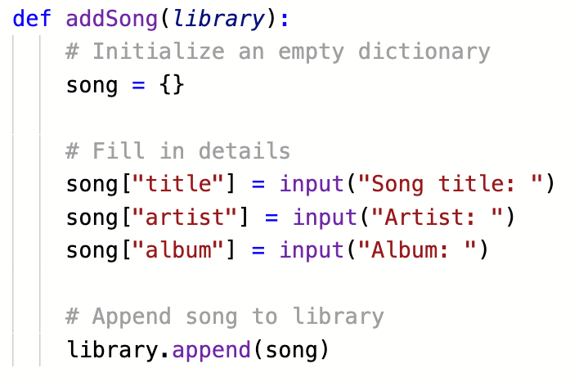
RECAP: using lists and dictionaries

Slide 11
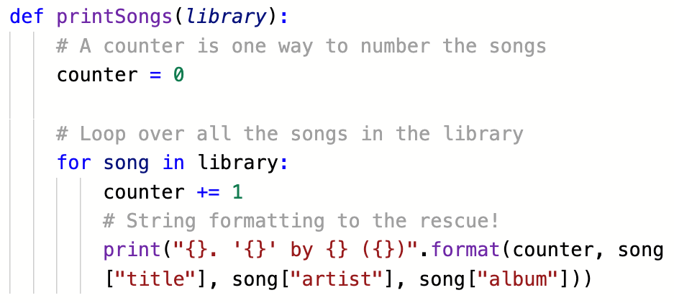
RECAP: lists and dictionaries
this feels
a little funny…

Slide 12
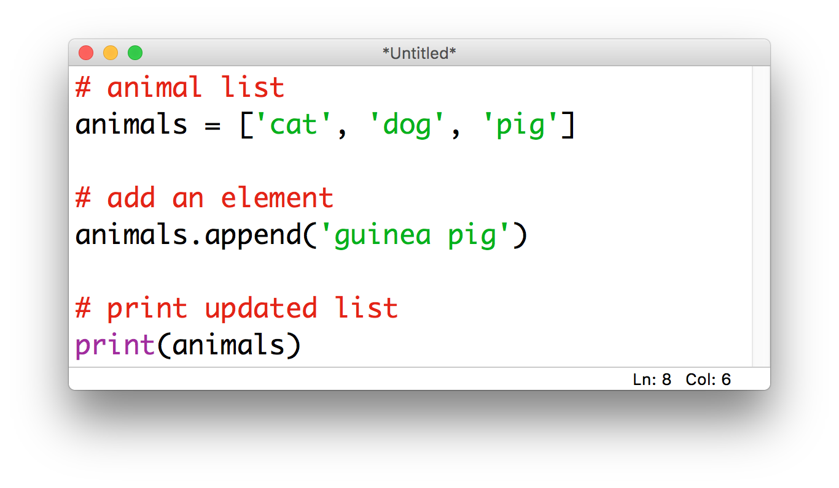
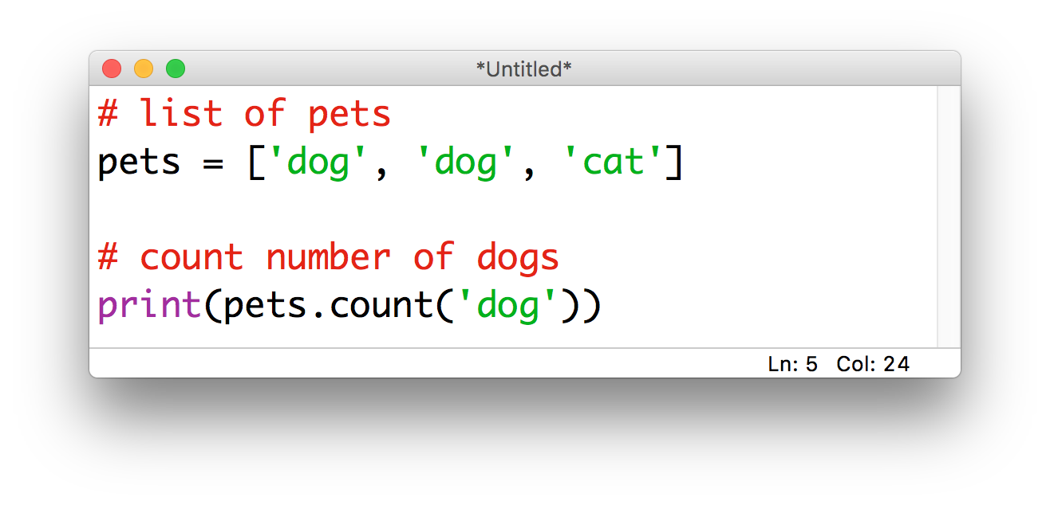
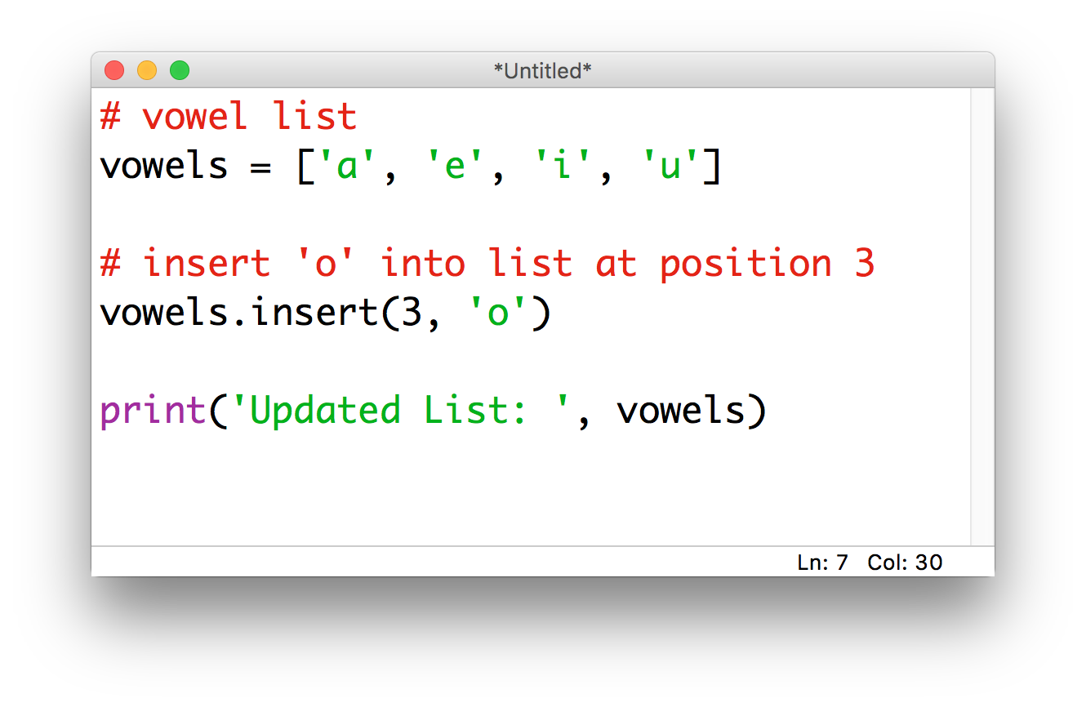
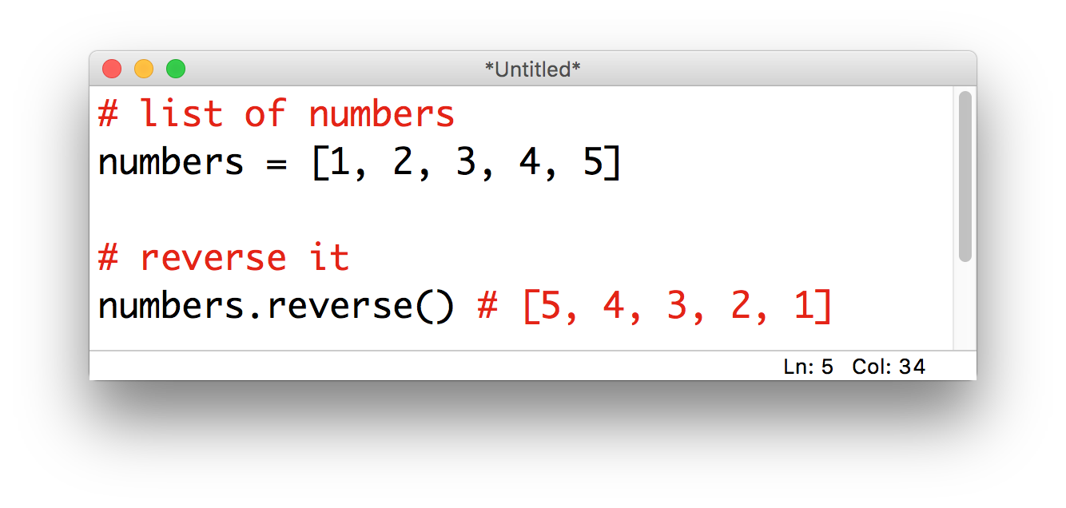
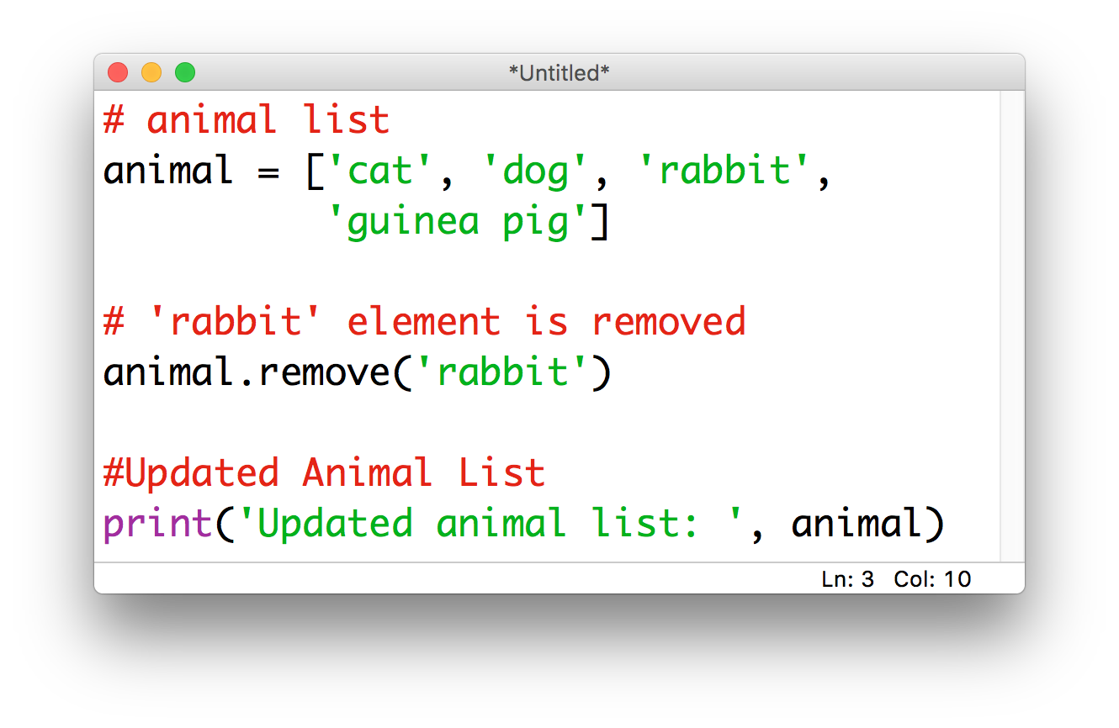
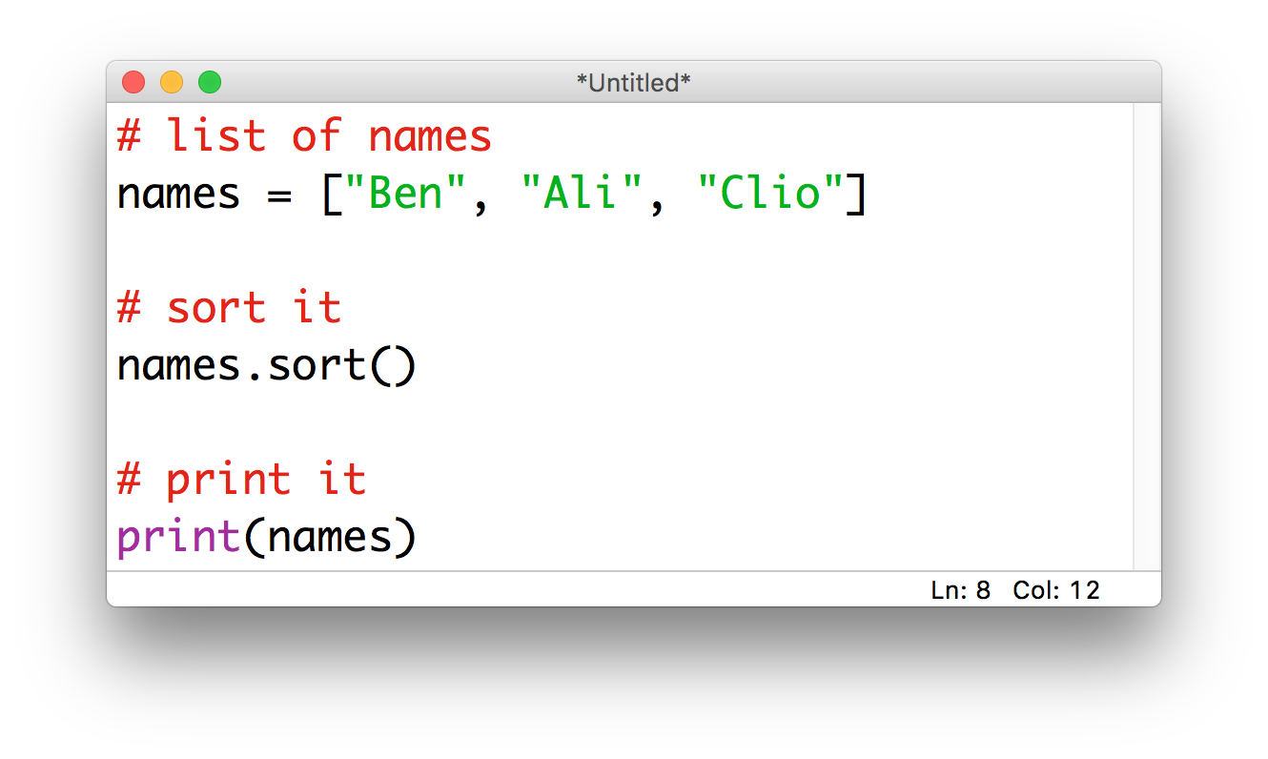
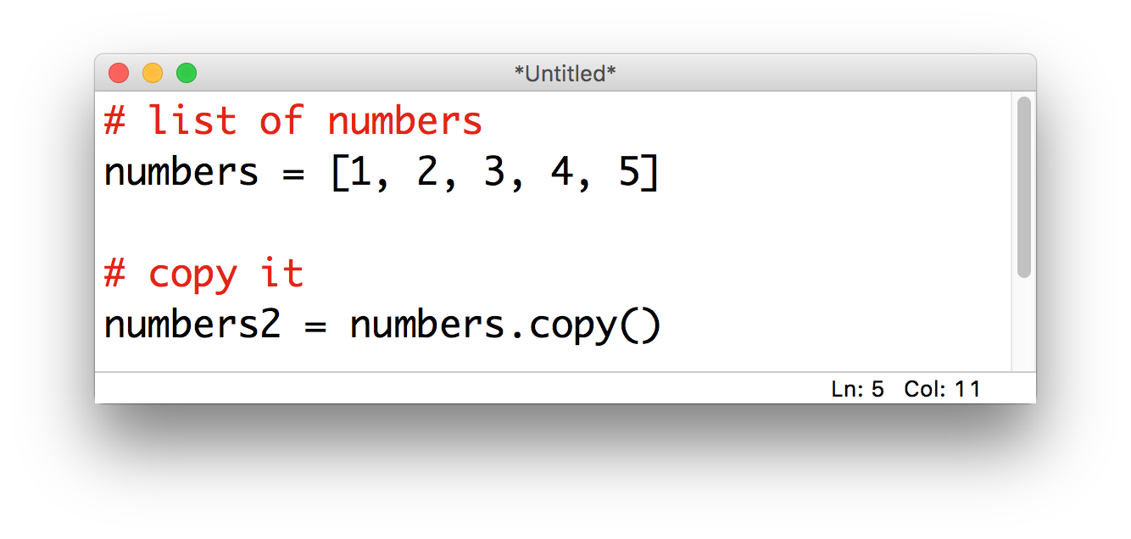
Discussion
Compare this with other operations we can perform on lists and dictionaries; what do you notice?

Slide 13
Discussion
So what’s the difference between
a function and a method?

Slide 14
Activity: functions vs. methods
Image courtesy: https://data-flair.training/blogs/python-method-vs-function/
Notes:
functions (in general) are things that are done BY a program TO an object
methods (in general) are things that are done BY an OBJECT TO or ABOUT itself
there are some things that “feel like” they should be methods, and others feel fine as functions
the difference is subtle, but let’s try to wrap out heads around it by thinking about it in terms of the real world
describe what someone is wearing (function)
tell me what’s in someone’s pocket (method)
make a circle around someone (function)
move someone’s chair somewhere else in the room (method)
get someone to sing the ABC’s (method)
class: put yourselves in order from tallest to shortest (could be either!)
Can you come up with other things that are probably better as methods than functions?
Are you starting to get a sense for an object’s “personal space”?
Good guideline: if it’s something an object could reasonably do for itself, it should (i.e. it should be a method, not a function)
If it changes anything about the object
Methods belong to the object, and they can access everything inside the object
When that thing needs to be done, you ask politely (i.e. call the method)

Slide 15

Back to the playlist: what we want
We’d like to be able to ask a Song to print() or play() itself (since it already has access to all the information)
That way we don’t have to waste time passing everything from function to function
To do this, we’ll need a way to combine functions (methods) and variables (attributes)
Solution: classes
Notes:
Let’s step away from our playlist example and look at something a little simpler

Slide 16
Building a Die class

Slide 17
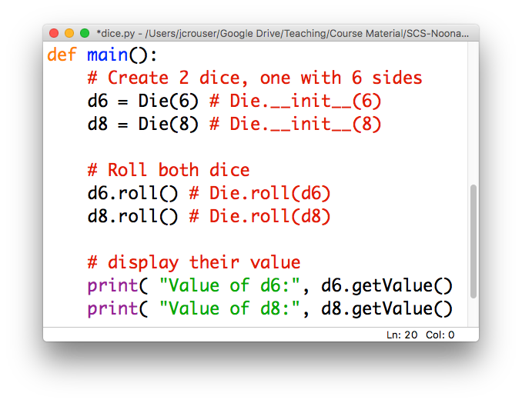
How this might look

Slide 18
Just one problem…
python
doesn’t know
how to do
any of this
we need to build it a blueprint

Slide 19
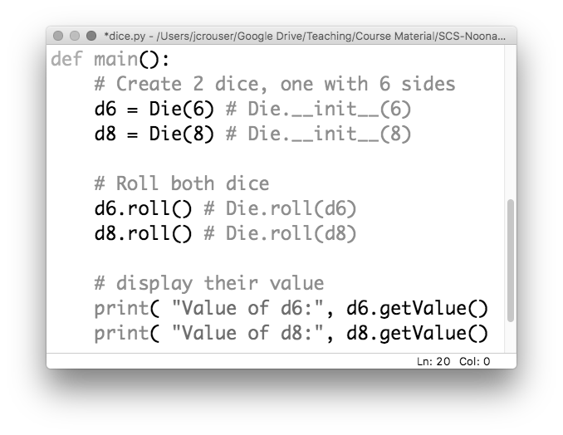
1. a way to build a Die given # sides

Slide 20
2. to be able to .roll() them

Slide 21
3. to be able to .getValue()

Slide 22
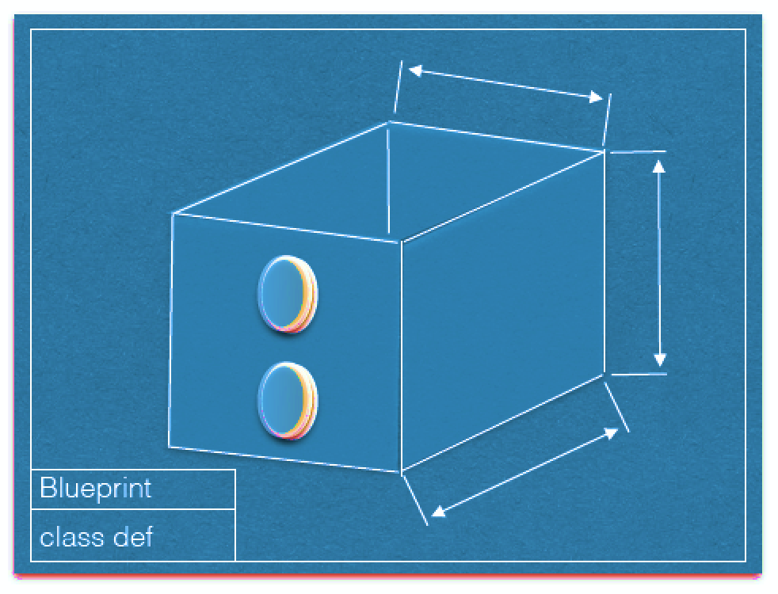
Blueprint for a Die
Image courtesy Dominique Thiebaut, Smith College

Slide 23
Blueprint for a Die: attributes
current_value
num_sides
Image courtesy Dominique Thiebaut, Smith College

Slide 24
Blueprint for a Die: methods
roll()
get_value()
Image courtesy Dominique Thiebaut, Smith College

Slide 25
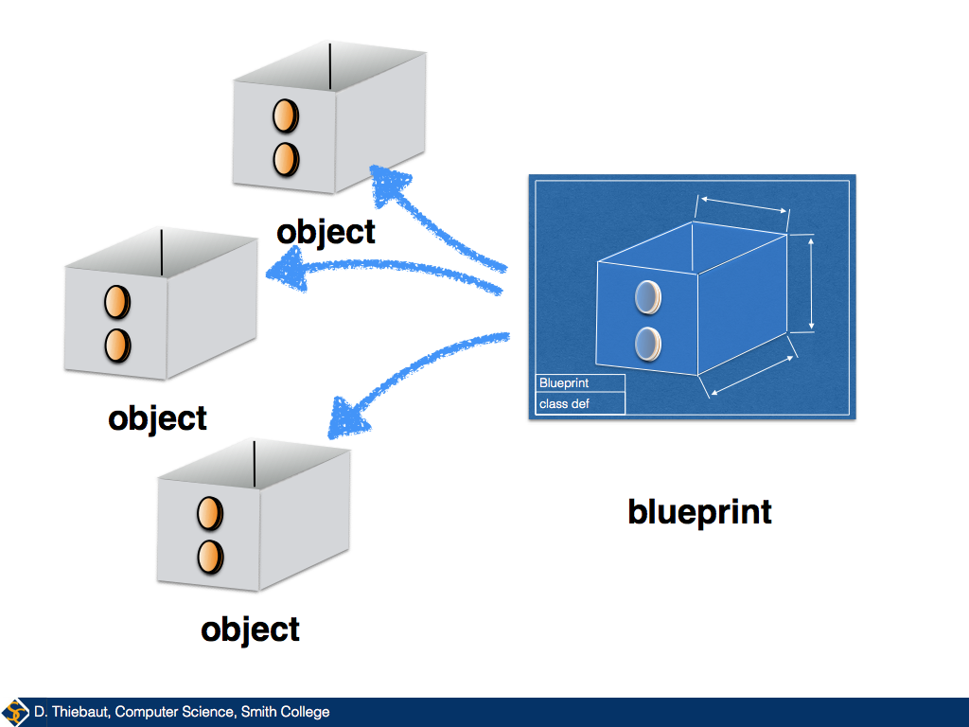
Given a blueprint, replication is easy

Slide 26
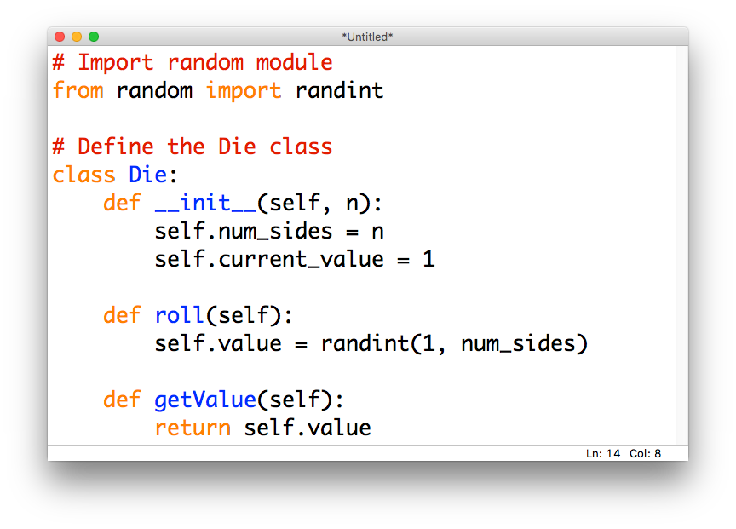
Coding the Die class
Should just be .value
Should be self.num_sides

Slide 27
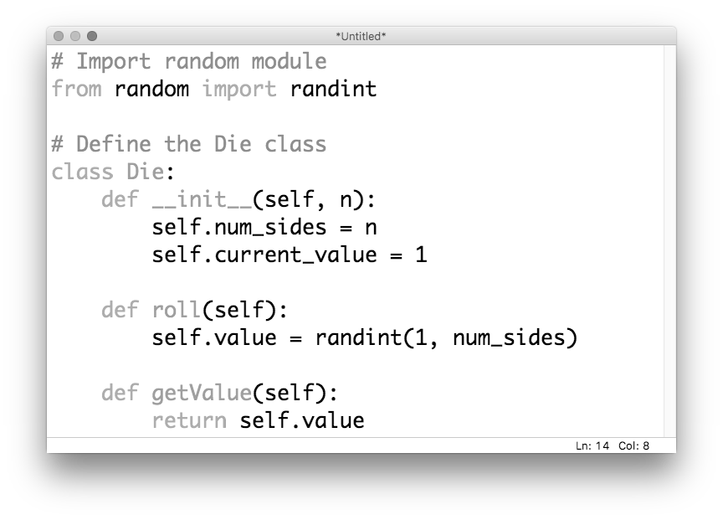
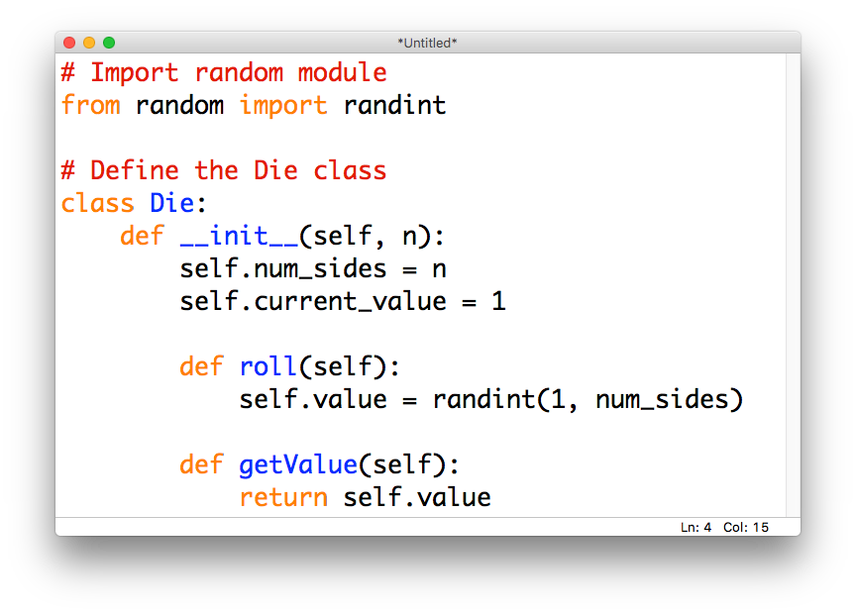
classes are defined using class
convention:
class names
start with a
capital letter

Slide 28
All classes need a constructor
attribute
values get
initialized
here
python
constructors
are always
called
__init__

Slide 29
methods are defined inside the class
nicely
indented

Slide 30
Question: what’s with all the selfs?

Slide 31
Question: what’s with all the selfs?
when attached
to a variable, self
makes the variable a
"member” of the object
(i.e. the object owns it)

Slide 32
Question: what’s with all the selfs?
every method in a class
automatically gets passed
a reference to the object
as its first parameter

Slide 33
Again, this happens automatically
we don’t put the self reference
into any of the method calls

Slide 34
But the effect is really cool

Slide 35
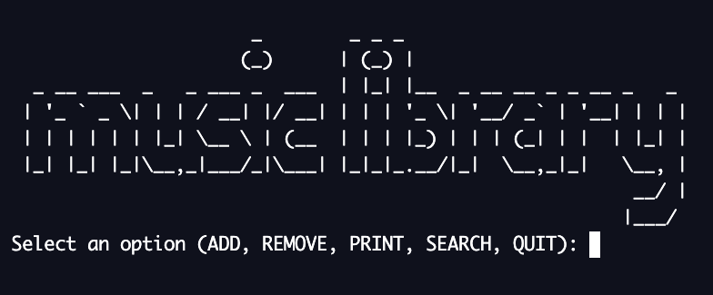
15-minute exercise: Classy Playlist
repl.it/@JordanCrouser/ClassyPlaylist

Slide 36
Discussion
What did you come up with?
How does the code compare with your first attempt?

Slide 37
Outline
A4 recap
Today: Classes pt. 1: attributes and methods
Monday: Classes pt. 2: object-oriented programming
Lab: working with classes
Wednesday: Classes pt. 3: inheritance
Friday: Introduction to Algorithms

